Slide 1
Autonomous Car Lane AND OBJECT INTERSACTION DETECTION
Student: Orian Dabod 308337062
https://github.com/orianhit/autonomousCar

Slide 2
agenda
Basic of OpenCV
How OpenCV relates to autonomous vehicle
Lane detection logic and implementation
Object detection & intersection logic and implementation
Why you NEED this in your car

Slide 3
Basic of OpenCV
OpenCV (Open Source Computer Vision Library) is a library of programming functions mainly for real-time computer vision
OpenCV project was initially an Intel Research initiative to advance CPU-intensive applications, part of a series of projects including real-time ray tracing and 3D display walls
Goals:
Open but also optimized code for basic vision infrastructure
Disseminate vision knowledge
portable, performance-optimized code available for free

Slide 4
How OpenCV relates to autonomous vehicle
Object Detection
One of the most crucial tasks in self-driving cars is detecting and tracking objects on the road, such as pedestrians, other cars, and traffic signs. OpenCV provides powerful tools for object detection.
Lane Detection
OpenCV is frequently used for lane detection in self-driving cars. By analyzing video streams from cameras mounted on the car, OpenCV algorithms can detect lane markings and determine the vehicle's position within the lane.

Slide 5
How OpenCV relates to autonomous vehicle
Image Processing
Image processing is an essential part of self-driving car systems, and OpenCV provides a wealth of image processing tools, including filtering, thresholding, and edge detection
3D Reconstruction
OpenCV can be used to create 3D maps of the environment around a self-driving car. By using stereo camera systems or LIDAR sensors, OpenCV algorithms can create a 3D point cloud of the surrounding area

Slide 6
Lane detection logic and implementation
We want to extract the current lane the car is currently on
Should switch if the car is moving to another lane
One option is to represent it by 2 lines
Data was needed so I contacted some datasets owners and searched the web

Slide 7

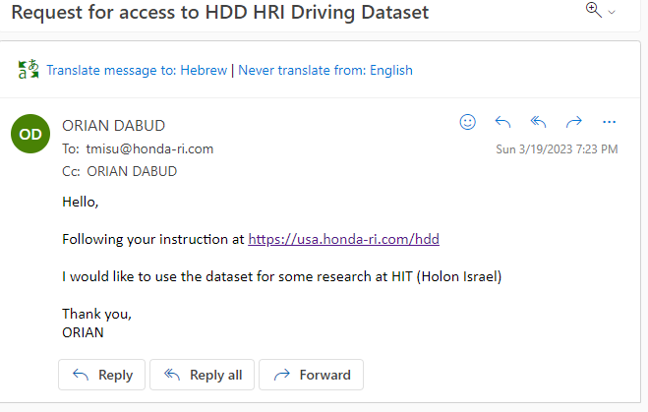
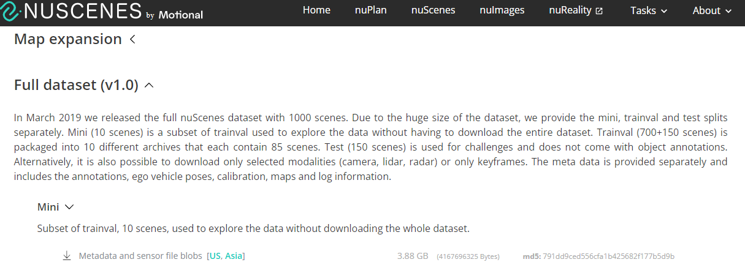

Slide 8
Lane detection logic and implementation
Manipulate the image
Color remove
Add blur
Use canny (edge detection)
Crop only region interesting

Slide 9
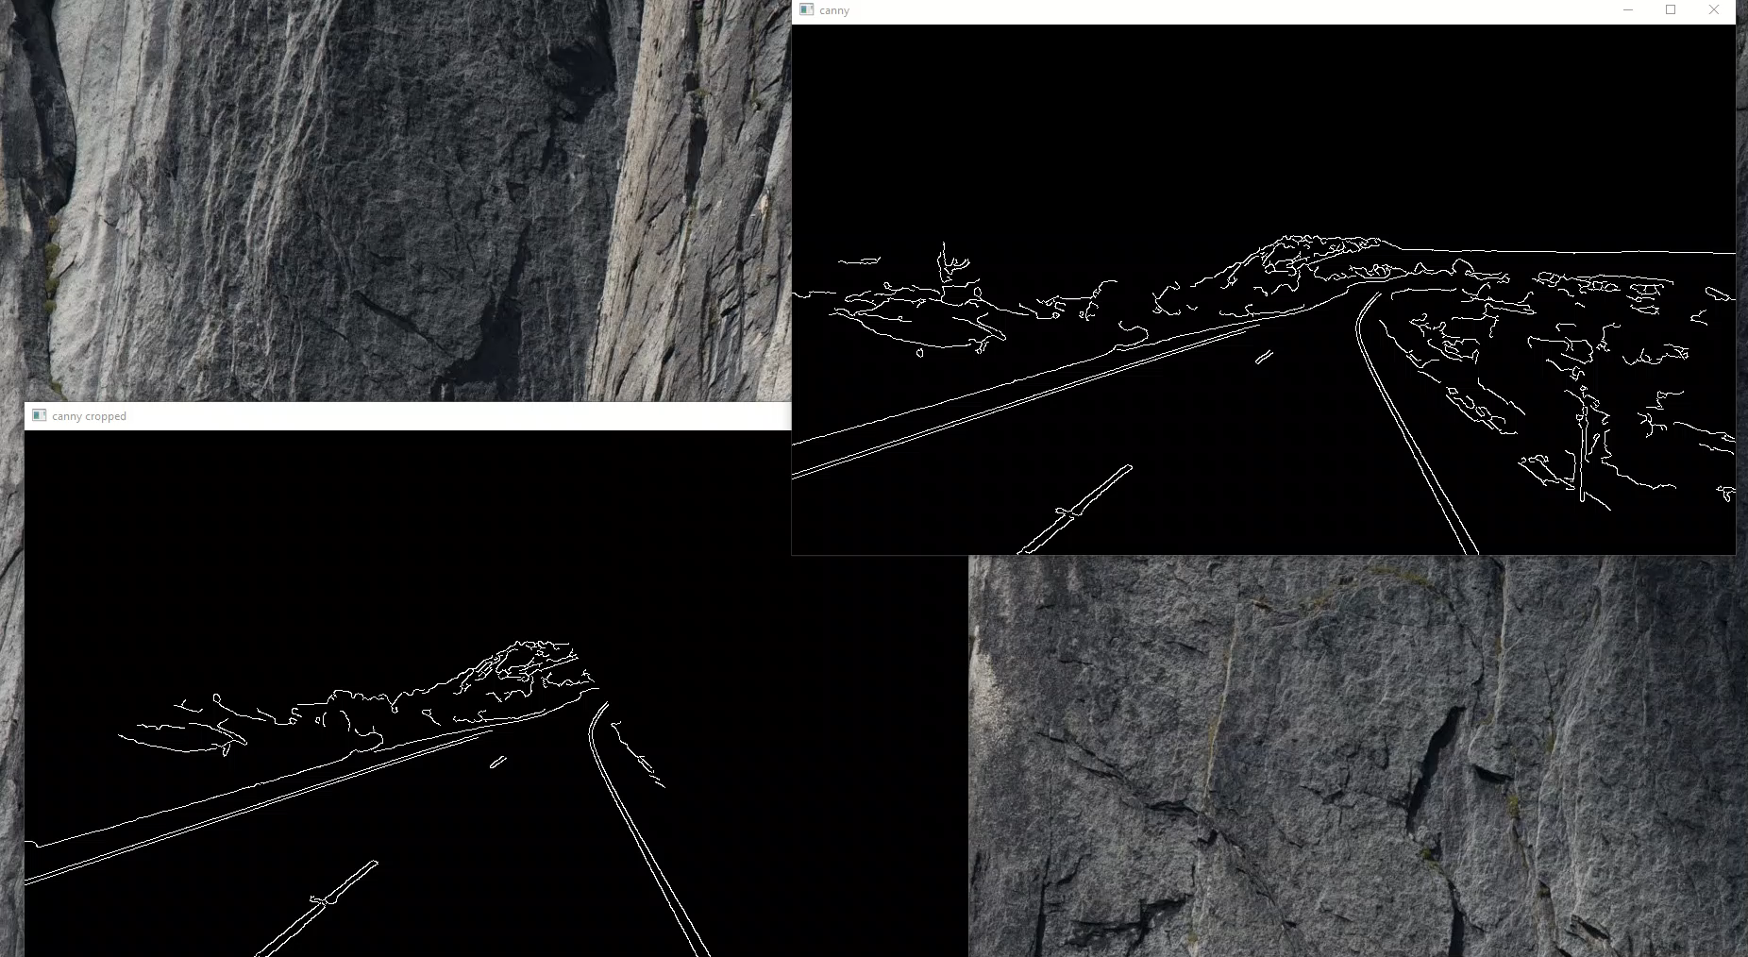
Lane detection logic and implementation

Slide 10
Lane detection logic and implementation
Find lines
Use hough lines (with hyperparams)
Use only semi horizontal lines (filter others)
Avg slop for creating 2 lines

Slide 11
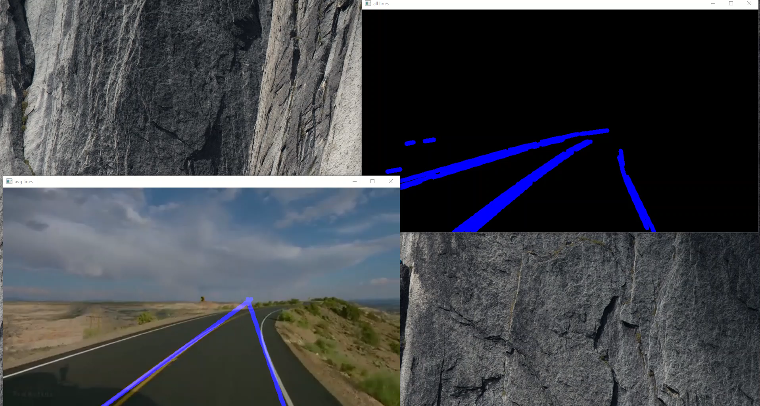
Lane detection logic and implementation

Slide 12
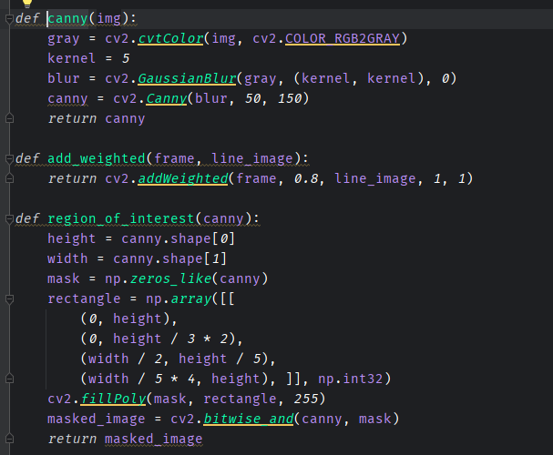
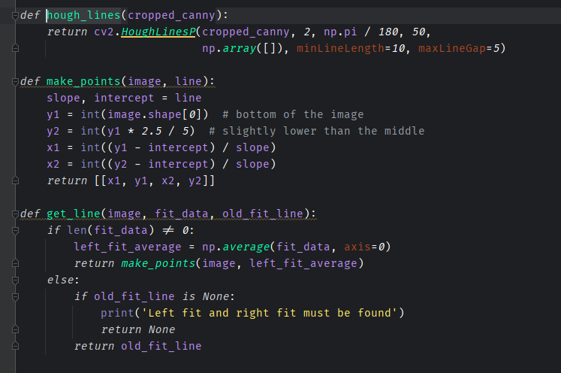
Lane detection logic and implementation

Slide 13
Object detection & intersection logic and implementation
Moving objects can be detected using diff between 2 following images
We will use localization (instead of segmentation) due to its better performance
When moving objects enters our line, aka there is intersection between line and the object this means we may enter an accident

Slide 14
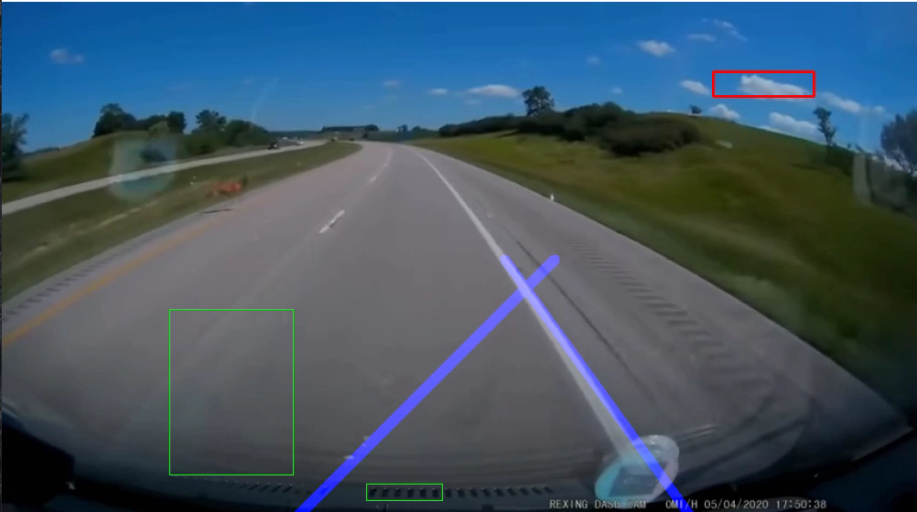
Object detection & intersection logic and implementation

Slide 15
Object detection & intersection logic and implementation
Moving objects can be detected using diff between 2 following images
We will use localization (instead of segmentation) due to its better performance
When moving objects enters our line, aka there is intersection between line and the object this means we may enter an accident

Slide 16
Conclusion (Why you NEED this in your car)
Using OpenCV is Cheap, both in terms of hardware and software
Lane detection may need some adjustments depends on your camera location
Object detection may save lives
OpenCV and AI in general are essential for autonomous vehicles
Using this cheap solution you may prevent the next accident

